Slide 1
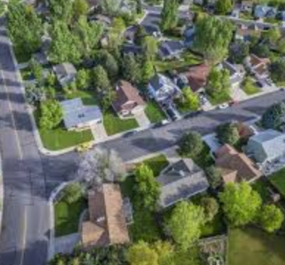
Capstone Project: Worcester Neighborhoods

Slide 2

Contents
Introduction
Data
Methodology
Results
Discussion

Slide 3
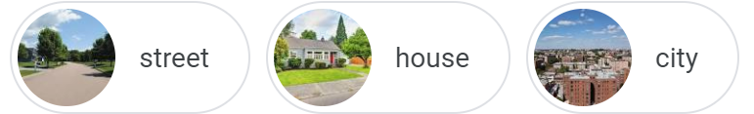
Introduction
A description of the background.
Our family live in Worcester County, MA. My husband has recently got a job in Boylston and his new office is located almost 15 miles away from home. This means his daily travel time is close to 1.5 hours. We are considering moving closer to his office to save time. We currently stay in the neighborhood of the city of Worcester, which is in the west of Worcester County, and his office is in Boylston, which is in the east of Worcester County. We don’t have to stay in Boylston where has a relatively high rent price. But we prefer moving to a neighborhood closer to his workplace and similar to our current neighborhood of Worcester.
Notes:
QuickStarter has created an outline to help you get started on your presentation. Some slides include information here in the notes to provide additional topics for you to research.
Summary:
A volcano is a rupture in the crust of a planetary-mass object, such as Earth, that allows hot lava, volcanic ash, and gases to escape from a magma chamber below the surface. Earth's volcanoes occur because its crust is broken into 17 major, rigid tectonic plates that float on a hotter, softer layer in its mantle. Therefore, on Earth, volcanoes are generally found where tectonic plates are diverging or converging, and most are found underwater. For example, a mid-oceanic ridge, such as the Mid-Atlantic Ridge, has volcanoes caused by divergent tectonic plates whereas the Pacific Ring of Fire has volcanoes caused by convergent tectonic plates. Volcanoes can also form where there is stretching and thinning of the crust's plates, e.g., in the East African Rift and the Wells Gray-Clearwater volcanic field and Rio Grande Rift in North America. This type of volcanism falls under the umbrella of "plate hypothesis" volcanism. Volcanism away from plate boundaries has also been explained as mantle plumes. These so-called "hotspots", for example Hawaii, are postulated to arise from upwelling diapirs with magma from the core–mantle boundary, 3,000 km deep in the Earth. Volcanoes are usually not created where two tectonic plates slide past one another.

Slide 4
Introduction
A discussion of the problems
Which neighborhoods in Worcester County are good choices for our family to move to?
These candidate neighborhoods should be both close to my husband’s new office and similar to our current living environment.
Notes:
QuickStarter has created an outline to help you get started on your presentation. Some slides include information here in the notes to provide additional topics for you to research.
Summary:
A volcano is a rupture in the crust of a planetary-mass object, such as Earth, that allows hot lava, volcanic ash, and gases to escape from a magma chamber below the surface. Earth's volcanoes occur because its crust is broken into 17 major, rigid tectonic plates that float on a hotter, softer layer in its mantle. Therefore, on Earth, volcanoes are generally found where tectonic plates are diverging or converging, and most are found underwater. For example, a mid-oceanic ridge, such as the Mid-Atlantic Ridge, has volcanoes caused by divergent tectonic plates whereas the Pacific Ring of Fire has volcanoes caused by convergent tectonic plates. Volcanoes can also form where there is stretching and thinning of the crust's plates, e.g., in the East African Rift and the Wells Gray-Clearwater volcanic field and Rio Grande Rift in North America. This type of volcanism falls under the umbrella of "plate hypothesis" volcanism. Volcanism away from plate boundaries has also been explained as mantle plumes. These so-called "hotspots", for example Hawaii, are postulated to arise from upwelling diapirs with magma from the core–mantle boundary, 3,000 km deep in the Earth. Volcanoes are usually not created where two tectonic plates slide past one another.

Slide 5
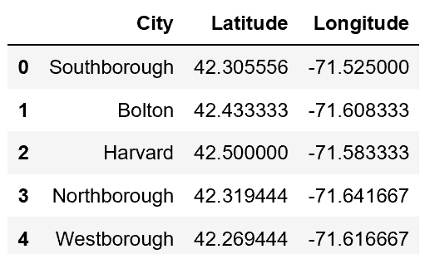
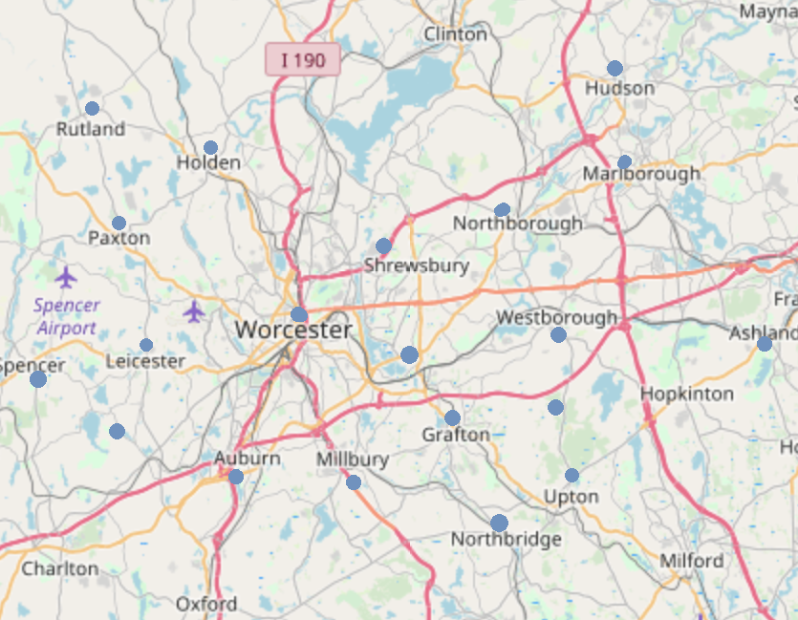
Data
To address this problem, we need:
1. Geographical Data of Worcester County neighborhoods - latitude and longitude details of the cities in Worcester County
2. Neighborhoods Environment Data - data describing interests and venues within a given radius

Slide 6
Data
Sources of Data:
1. For the latitude and longitude coordinates of neighborhoods, our primary source of information is the following Wikipedia page: https://en.wikipedia.org/wiki/Worcester_County,_Massachusetts
This wiki page comprises a list of links to 60 cities/towns neighborhoods. Each link contains the latitude and longitude of that particular location. Hence, we can compile a database of 88 neighborhoods in Worcester County from these wiki pages, using a web-scraping tool i.e. BeautifulSoup.
2. For neighborhood environment details, we use the Foursquare database. Since we are interested in the character and composition of each neighborhood, we use the ‘explore’ endpoint to learn about the popular venues in each neighborhood.

Slide 7
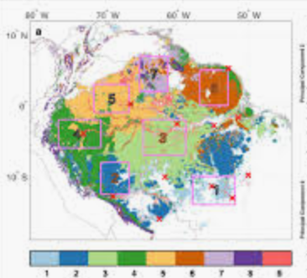
Methodology
We will run a unsupervised k-means clustering model to look for similar locations as our current neighborhood.

Slide 8
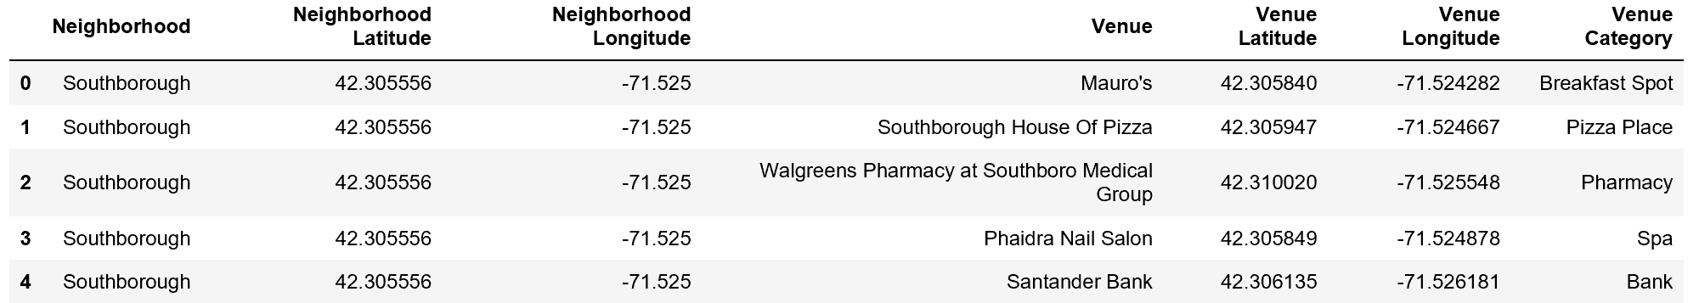
Results
We get venues for every neighborhood by popularity and proximity.

Slide 9
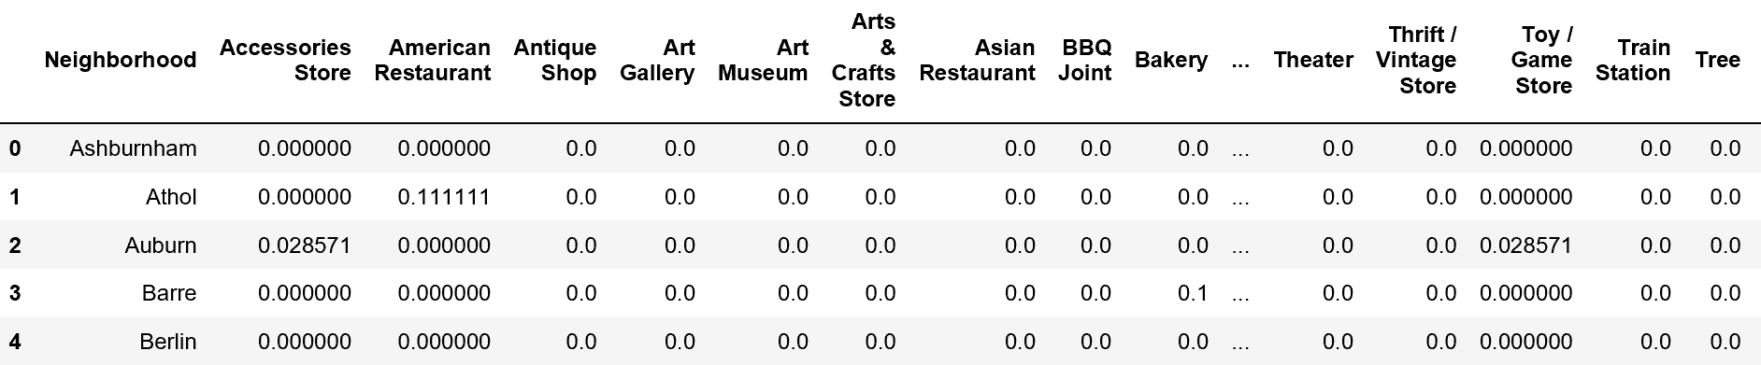
Results
Group by neighborhood and calculate the mean value for type of venue.

Slide 10
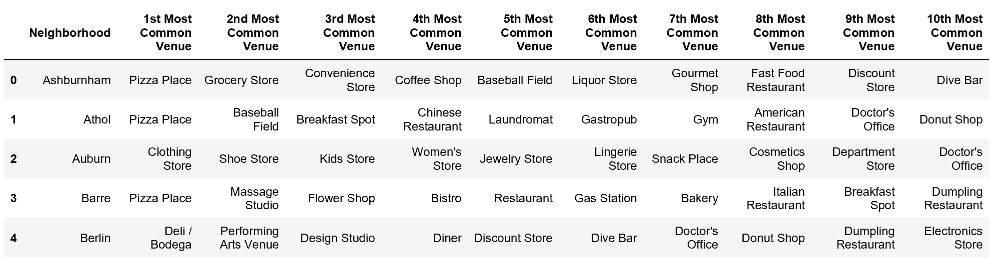
Results
Identify the top ten venues for each neighborhood.

Slide 11
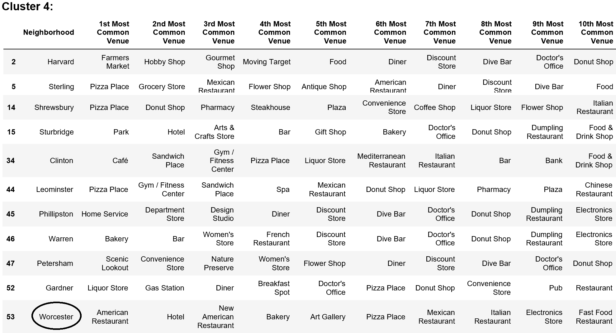
Results
Use the K-means Clustering to group similar neighborhoods.
These are neighborhoods similar to Worcester.

Slide 12
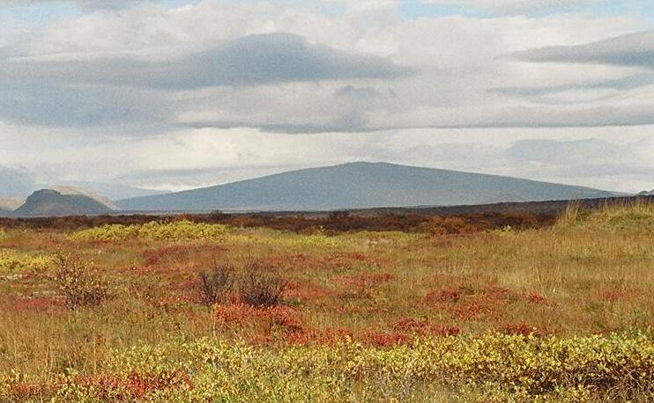
Volcanic features
Look in the slide notes below for topics to consider talking about
Notes:
Consider talking about:
Fissure vents
Shield volcanoes
Lava domes
Cryptodomes
Volcanic cones (cinder cones)
Stratovolcanoes (composite volcanoes)
Supervolcanoes
Underwater volcanoes
Subglacial volcanoes
Mud volcanoes

Slide 13

Discussion
The neighborhood of Gardner, Petersham, and Warren come closest to our current neighborhood in terms of nearby venues. But these neighborhoods are still far away from my husband's workplace. Since our first consideration was to reduce his travel time, we might want to assess a few more neighborhoods in the same Cluster as Worcester.

